Slide 1
The courage of compassion: supporting midwives to deliver high-quality care(king Fund,2020)
Actions to support midwives in enhancing the quality of care for women and their families.

Slide 2
context
Before the pandemic the nursing and midwifery staff force had been under immense pressure ( RCN,2019)
High sickness rate related to sickness, stress and burnout with 51% of midwives reporting work stress-related sickness according to the NHS Survey (RCN, 2019)
With COVID 19
Unprecedented pressure on the workforce with unfilled vacancy positions with the NHS
There are large growing gaps between capacity and demand in nursing services. ( Kings Fund, 2020)
Result – Alarming intention to quit with
Absenteeism
More staff attending work despite not feeling/ fit enough to perform their duties

Slide 3
Core work needs of all staff
For all human beings to thrive we all have needs according to Maslow’s Hierarchy of needs.
For staff to thrive and deliver quality services to end users
3core needs have been identified according to research (King’s Fund, 2020)
AUTONOMY-need to have control over work lives, influence over decisions, act consistently with their values
BELONGING: The need to feel valued, respected and supported.
CONTRIBUTION: The need to experience effectiveness in what they do with valued outcome

Slide 4
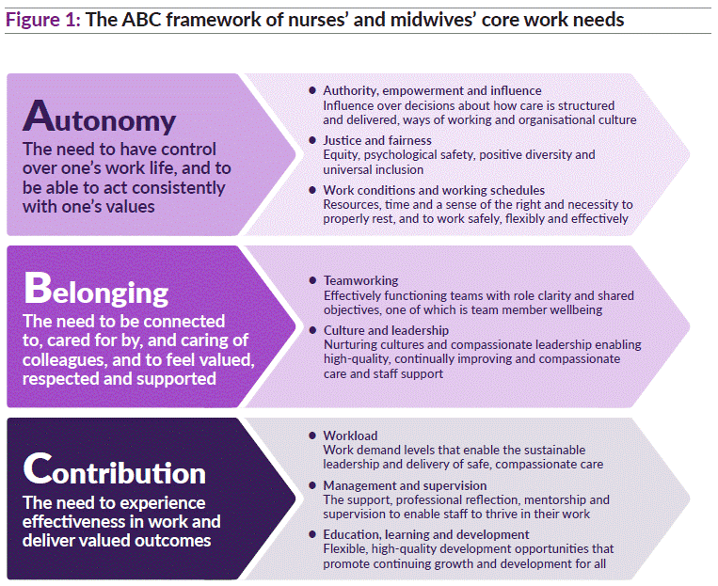

Slide 5
Actions and recommendations to support Midwives.
Authority, empowerment and influence, promoting decisional autonomy for women
Perception of choice is a feature of a sense of autonomy –achieved by flexible working patterns offered by the employer.
Justice and fairness-positive, Safe culture of openness to equity diversity and inclusion.
Working conditions and work schedules: standard facilities to provide rest, food, and scheduled breaks. Influence on rosters accommodating family life and promoting work-life balance ( reduces staff emotional stress)

Slide 6
Actions and recommendation to support midwives
Belonging: The need to feel connected, valued, heard and respected
Team working, stable work team with a nurturing culture for students and young professional midwives
Compassionate, Supportive leadership with concerns for staff well-being
No blame feedback and learning from incidents frameworks
Positive acceptance – builds Team morale
Belonging need if met- promote
High-quality care for end users
Empower professionals to thrive
Build courage and learning ability

Slide 7
CONTRIBUTION: The need to experience supportive management in order to thrive
Contribution: The need to experience supportive management to enable midwives to thrive in their respective workplaces.
Professional support
Reflection
Audit /staff survey
Mentorship
Preceptorship
Supervision
Continuous learning opportunity
Effective capacity building

Slide 8
conclusion
Midwives can only deliver high-quality care to pregnant women and their families if they are adequately supported and able to thrive in their respective workplaces.
Quality care can only be achieved if professional leaders lead with compassion.
High standard of care can only be achieved in an environment that ensure individuals health and wellbeing is prioritised.
When fairness and compassion are promoted individual well-being is fostered and quality care can be achieved
Organisation that meet midwive’s fundamental needs for autonomy, belonging where workers are able to make effective contribution in their work, turns out to have improved quality of care and efficiency.
Finally promotes wellbeing of pregnant women and their families.

Slide 9
References

